Slide 1
PDCP Ciphering in 4G/5G Networks
Present By Group 3 :
55984 – Vikas Srivastava
58622- Harshinie M
58623 – Shreyash Bhatt
58624 – Jayavarshini G
58635 – Yuvaraj P

Slide 2

Understanding PDCP Ciphering in 5G Networks
Delve into the critical role of Packet Data Convergence Protocol (PDCP) ciphering, a fundamental security mechanism safeguarding data in the advanced world of 5G communications. This presentation explores its functions, importance, and operational nuances within the 5G ecosystem.

Slide 3
What is PDCP? The Backbone of 5G Data Security and Efficiency
The Packet Data Convergence Protocol (PDCP) is an indispensable layer within the 5G New Radio (NR) stack, strategically positioned between the Radio Link Control (RLC) and Radio Resource Control (RRC)/Service Data Adaptation Protocol (SDAP) layers. It acts as a critical interface, processing both user plane (actual data traffic) and control plane (signalling) data.
1
2
Header Compression
Sequence Numbering
Efficiently reduces overhead by compressing IP headers, optimising bandwidth usage.
Ensures in-order delivery of data packets and supports duplication detection.
3
4
Integrity Protection
Ciphering
Safeguards control plane messages from unauthorised modifications.
Encrypts data payloads for confidentiality, preventing eavesdropping.
PDCP's comprehensive functionalities are meticulously defined by the 3GPP TS 38.323 specification, underscoring its pivotal role in secure and efficient 5G communication.

Slide 4
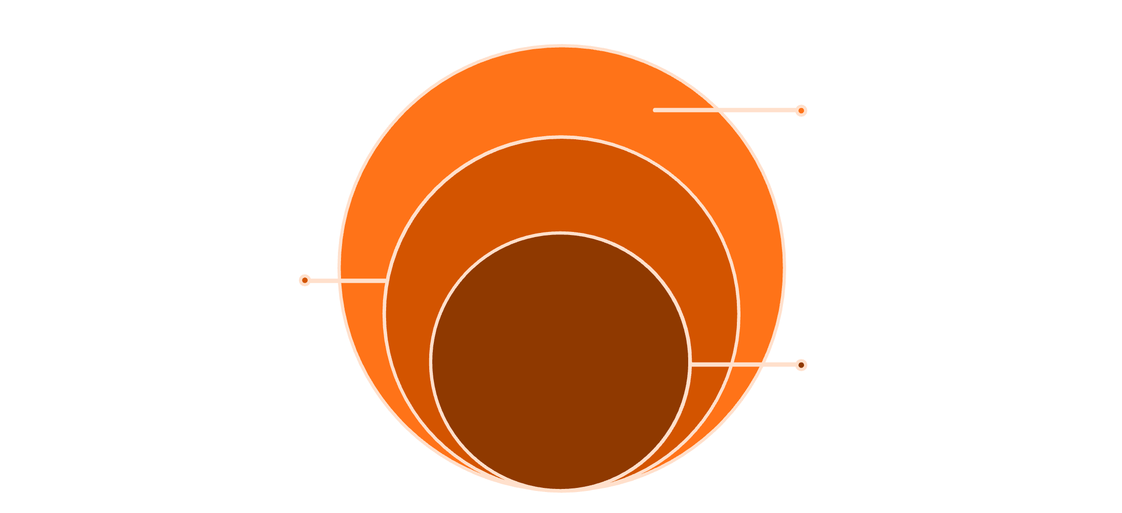
What is PDCP ( Packet Data Convergence Protocol ) ?
The Packet Data Convergence Protocol (PDCP) is a critical layer within the LTE and 5G mobile network protocol stack. Positioned strategically above the Radio Link Control (RLC) layer, PDCP is primarily responsible for robust security functions, efficient data handling, and optimising data transmission over the air interface.
RLC Layer
PDCP Position in Protocol Stack
Segmentation, retransmission, flow control
PDCP works as an intermediary layer between the IP (Internet Protocol) layer and the RLC (Radio Link Control) layer.
It acts as a crucial security gateway, ensuring data integrity and confidentiality for all user traffic.
PDCP protects data packets through ciphering and integrity protection before their transmission over the wireless network.
It also manages header compression, reordering, and duplicate detection to enhance efficiency.
PDCP Layer
Header compression and encryption
IP Layer
End-to-end IP packets
This diagram illustrates PDCP's position, bridging the higher-level IP layer (where data packets originate) and the lower-level RLC layer (which manages radio link specifics).

Slide 5
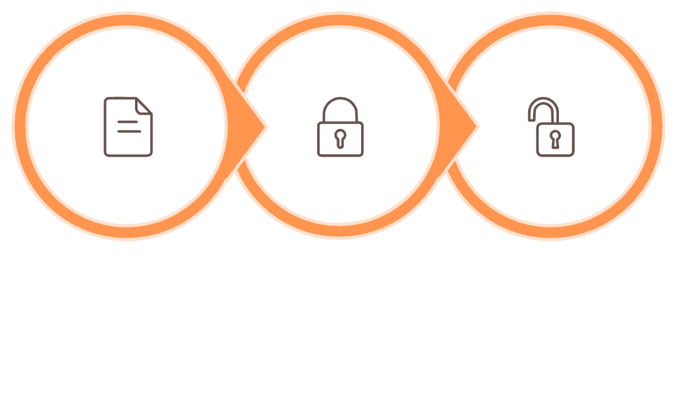
What is Ciphering ?
The Process of Ciphering
Why Ciphering is Needed
Ciphering is the process of encrypting data.
It converts plain data into an unreadable format, also known as ciphertext.
Only an authorized receiver, possessing the correct decryption key, can convert the ciphertext back to plain data.
It is crucial for protecting both user information and control signaling in communication systems.
Wireless communication inherently involves broadcasting signals, making it open and vulnerable to interception.
Data transmitted over radio signals can be easily captured by unauthorized parties.
Ciphering acts as a vital protective layer, securing data before its transmission over the air interface.
Simple Example of Ciphering
Plain Data
Encrypted Data
Decrypted Data
(HELLO)
(X#9@P)
(HELLO)

Slide 6




PDCP Ciphering Process
PDCP ciphering is the fundamental process within 4G/5G networks that ensures the confidentiality and integrity of user data and control plane signaling. It transforms plain data into an unreadable format, safeguarding it from unauthorized access during wireless transmission.
1. Data Reception
The PDCP layer receives user data (PDCP SDU) from the upper IP layer, ready for secure transmission.
2. Key Selection
Based on network configuration and security policies, the appropriate ciphering key and security parameters are selected.
3. Parameter Setup
Critical parameters such as the COUNT value, bearer identity, and data direction (Uplink/Downlink) are prepared for the ciphering algorithm.
4. Encryption
The selected ciphering algorithm applies the key and parameters to the PDCP SDU, converting it into encrypted data (ciphertext).
5. PDU Generation
The encrypted data is then encapsulated along with a PDCP header to form the Encrypted PDCP PDU.
6. Forwarding to RLC
The Encrypted PDCP PDU is forwarded to the Radio Link Control (RLC) layer for segmentation, retransmission handling, and eventual transmission over the air interface.
Key Characteristics
Bidirectional
Layer-Specific
The ciphering process is applied uniformly for both uplink (device to network) and downlink (network to device) data flows, ensuring end-to-end security.
Ciphering is exclusively performed at the PDCP layer. Once encrypted, lower layers only handle the ciphertext without needing to know the original content.
Transparent to RLC/MAC
Efficient & Low Latency
The RLC and MAC layers treat the encrypted PDCP PDU as regular data, maintaining a transparent and efficient protocol stack operation.
The chosen ciphering algorithms are optimized for speed, ensuring minimal latency impact on data transmission, crucial for real-time applications.

Slide 7
PDCP Ciphering Message Flow Diagram
Downlink (Network → UE)
Uplink (UE → Network)
Data arrives at PDCP layer
Ciphering key applied
Data encrypted
Forwarded to RLC/MAC/PHY
UE decrypts at PDCP
Data enters PDCP layer
Ciphering key applied
Data encrypted
Sent over air interface
Network decrypts at PDCP

Slide 8
PDCP Ciphering Algorithms
Common PDCP Ciphering Algorithms
LTE (4G) Algorithms:
5G NR Algorithms:
EEA0 (No ciphering)
EEA1 (SNOW 3G)
EEA2 (AES)
EEA3 (ZUC)
NEA0 (No ciphering)
NEA1 (SNOW 3G)
NEA2 (AES)
NEA3 (ZUC)
Algorithm Characteristics
EEA1/NEA1 (SNOW 3G)
EEA2/NEA2 (AES)
EEA3/NEA3 (ZUC)
Stream cipher algorithm
128-bit key length
Suitable for high-speed data transmission
Block cipher algorithm
128-bit key length
Most widely used in modern networks
Strong security properties
Stream cipher algorithm
128-bit key length
Developed by Chinese cryptography standards
Used in certain regions
Key Points
Network operator selects the algorithm during connection setup
Same algorithm used for both uplink and downlink
Algorithm negotiation happens during RRC connection establishment
Multiple algorithms provide flexibility and security options

Slide 9

Visual: PDCP Layer Data Flow with Ciphering Highlighted
Upper Layer
Ciphering
PDCP
This diagram illustrates the journey of data through the PDCP layer. Ciphering ensures data confidentiality before radio transmission, acting as a critical security gate. Without this step, sensitive information could be vulnerable to interception, compromising the privacy and security of 5G communications.

Slide 10
Ciphering vs. Integrity Protection: Different but Complementary
While both ciphering and integrity protection are fundamental security features within 5G's PDCP layer, they serve distinct yet complementary roles in safeguarding data. Understanding their individual functions is crucial for appreciating the holistic security architecture.
Ciphering
Integrity Protection
Primarily encrypts the data payload to ensure confidentiality.
Goal: To keep the content of the message secret.
Applies to both control plane and user plane traffic.
Prevents eavesdropping.
Authenticates control plane messages to prevent tampering.
Goal: To ensure the message has not been altered and originates from a legitimate source.
Mainly applies to control plane traffic (e.g., RRC and NAS signalling).
Utilises Message Authentication Codes (MAC-I).
Together, they provide a robust security posture: ciphering protects what is being communicated, while integrity protection ensures who is communicating and that the message is unchanged.

Slide 11
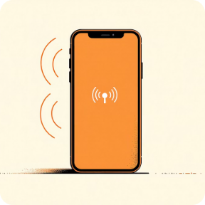
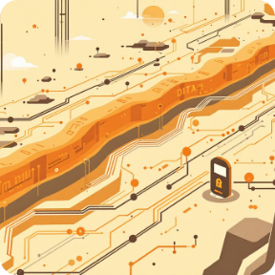


PDCP Ciphering in Action: Real-World Impact
Signalling Protection
User Data Security
URLLC Support
Attack Prevention
Protects critical RRC (Radio Resource Control) and NAS (Non-Access Stratum) signalling messages, which are vital for network operations like handovers between cell towers and the establishment of data bearers.
Secures diverse user data streams, encompassing sensitive communications such as Voice over IP (VoIP) calls, high-definition video streaming, and general internet traffic, ensuring end-to-end confidentiality.
Crucially supports Ultra-Reliable Low Latency Communication (URLLC) by enabling secure duplication of PDUs. This mechanism ensures data integrity and availability for mission-critical applications where security and reliability are paramount.
Acts as a formidable defence against various cyber threats, particularly preventing interception and replay attacks, where malicious actors attempt to resend legitimate data to gain unauthorised access or disrupt services.

Slide 12
Key Benefits of PDCP Ciphering in 5G
PDCP ciphering is not just a technical necessity but a strategic advantage for 5G networks, bringing a multitude of benefits that underscore its importance.
Enhanced Privacy
Secure Services
Maintains user privacy and trust, crucial for the widespread adoption and acceptance of 5G technologies.
Enables the secure deployment of advanced 5G services, from remote surgery and connected healthcare to autonomous vehicles and smart city infrastructure, where data integrity is non-negotiable.
Seamless Integration
Flexible Security
Works seamlessly alongside other vital PDCP functions, such as header compression and data duplication, creating a cohesive and highly efficient data processing pipeline.
Offers flexibility in its application, allowing ciphering to be enabled or disabled on a per-bearer basis. This adaptability ensures that security measures can be tailored to the specific needs and sensitivity of different data streams, optimising both performance and protection.

Slide 13
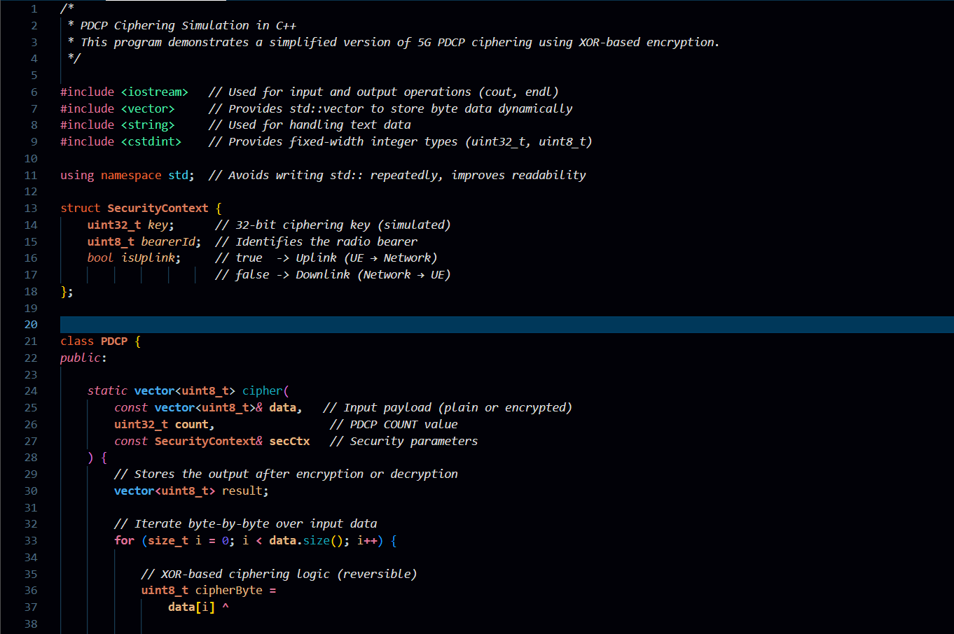
CODE :

Slide 14
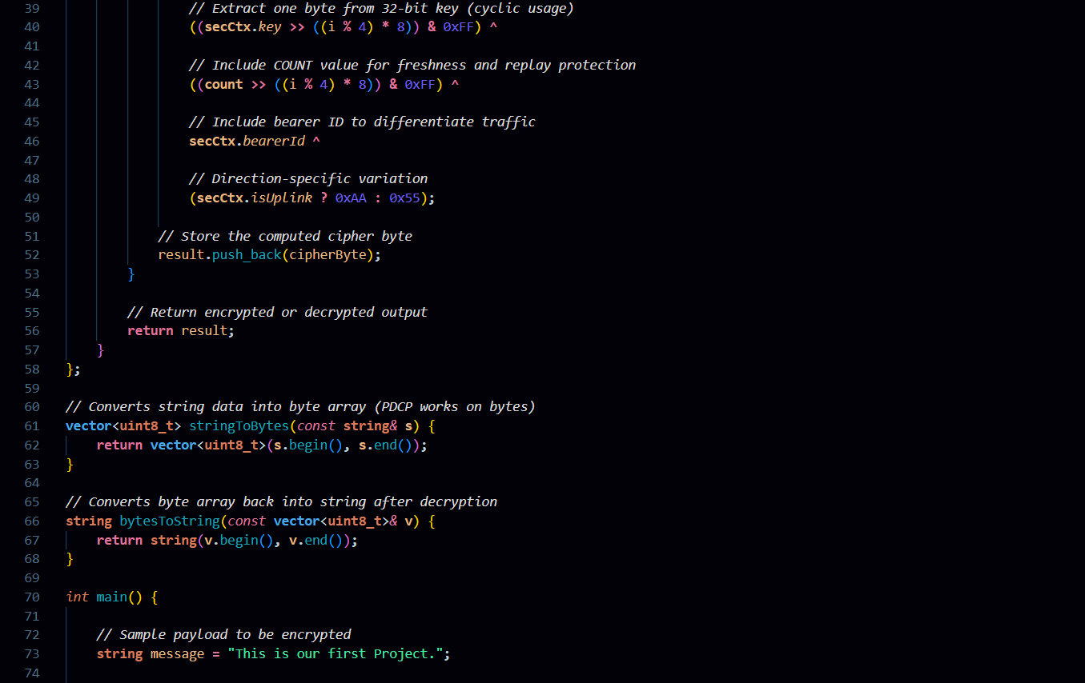

Slide 15
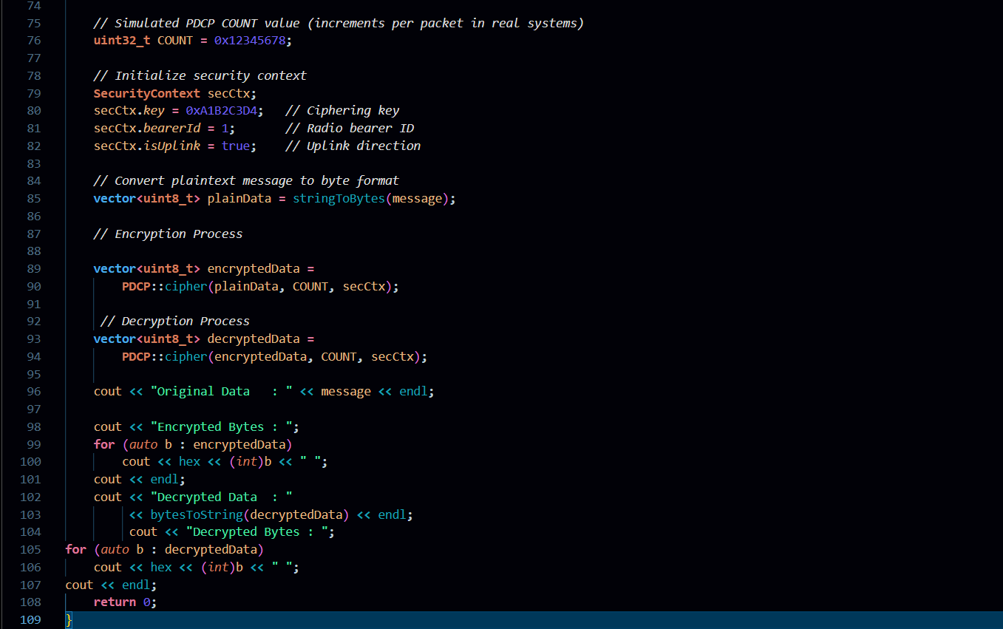

Slide 16
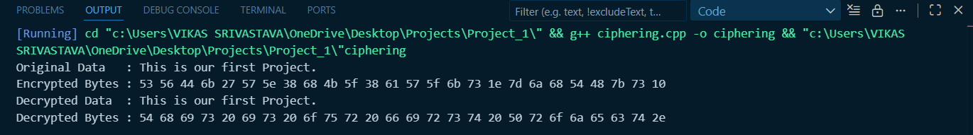
OUTPUT :

Slide 17
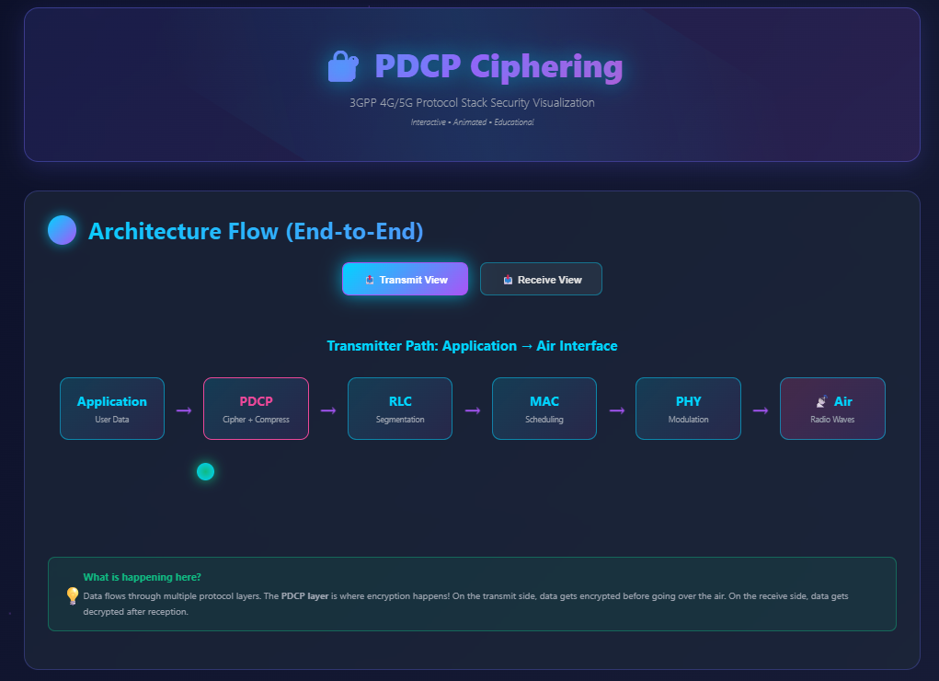
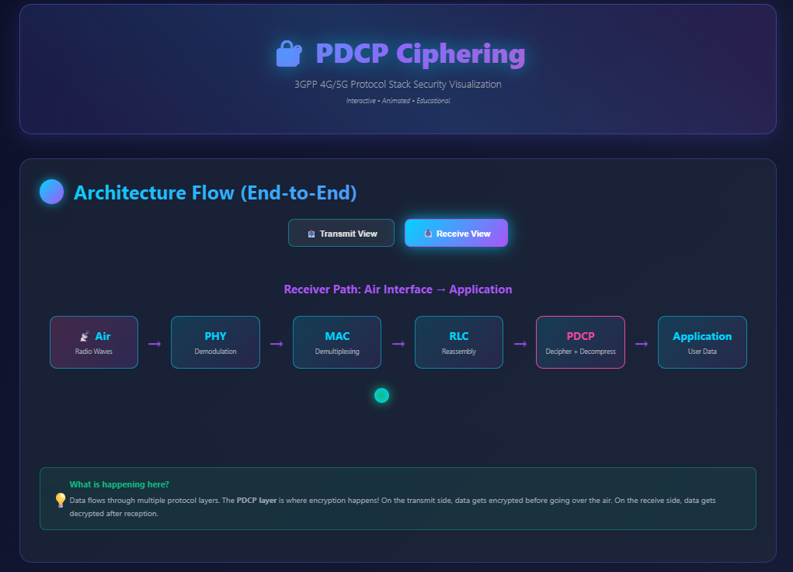
WEBPAGE
a. Transmit View b. Receive View

Slide 18
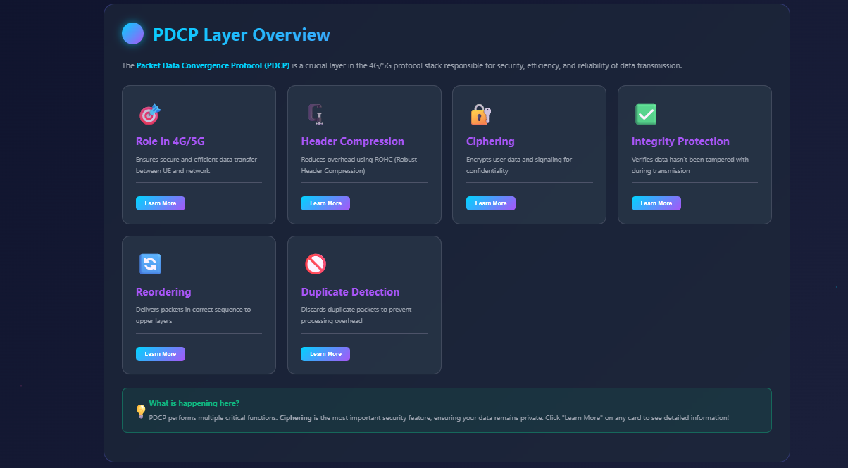

Slide 19

Conclusion: PDCP Ciphering – The Silent Guardian of 5G Data
PDCP ciphering stands as a foundational element within the 5G security architecture, diligently working in the background to ensure data confidentiality and integrity. It is the silent guardian, protecting the privacy of billions of connected devices and enabling the secure operation of an increasingly interconnected world.
Understanding the intricacies of PDCP ciphering allows us to appreciate the immense complexity and sophistication behind secure wireless communication. As 5G technology continues to advance and integrate into every facet of our lives, the role of PDCP ciphering will remain paramount, indispensable for building and maintaining trustworthy, high-performance networks.

